Slide 1


Admission module (online admission apply starting process)
Directorate of it university of malalkand

Slide 2

Overview of Topics
Create Admission Register
Add Programs
Education Required Details
Fee Setup
Create Degrees
Start Admission Register
Check Applications (Apply Forms)

Slide 3
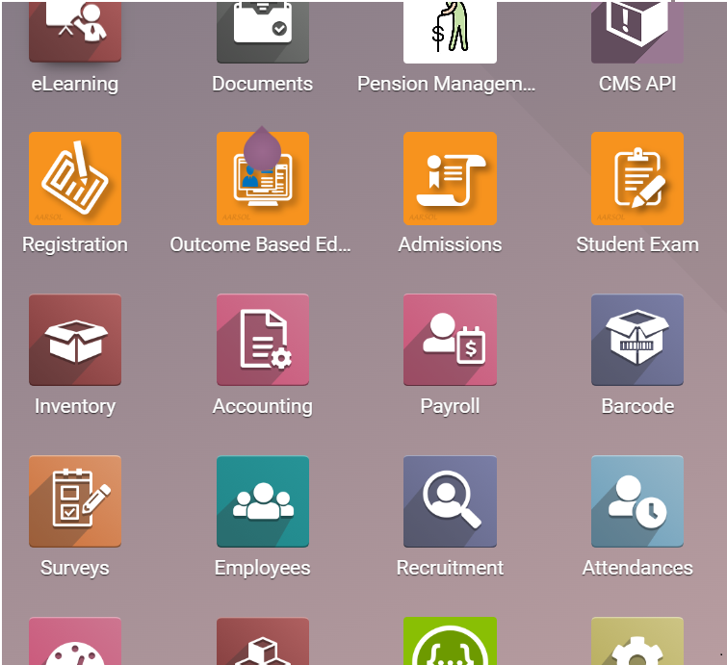
admission register creation
To create an admission register, we will open the admission module
1. Admissions Module

Slide 4
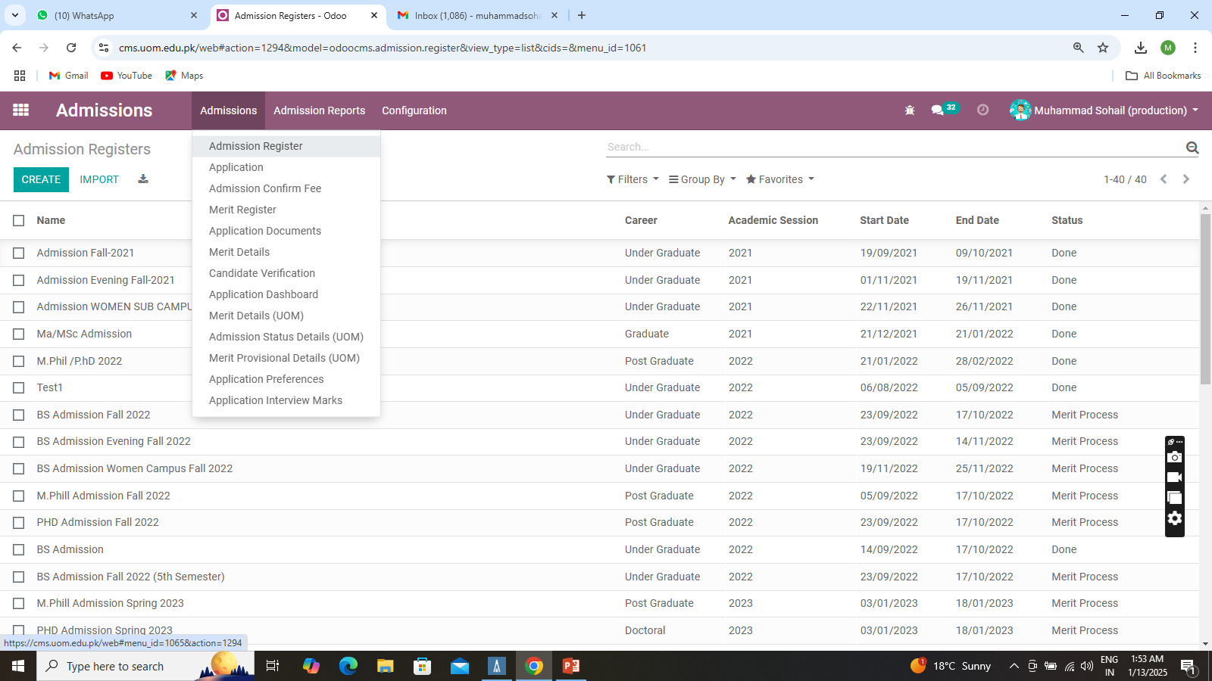
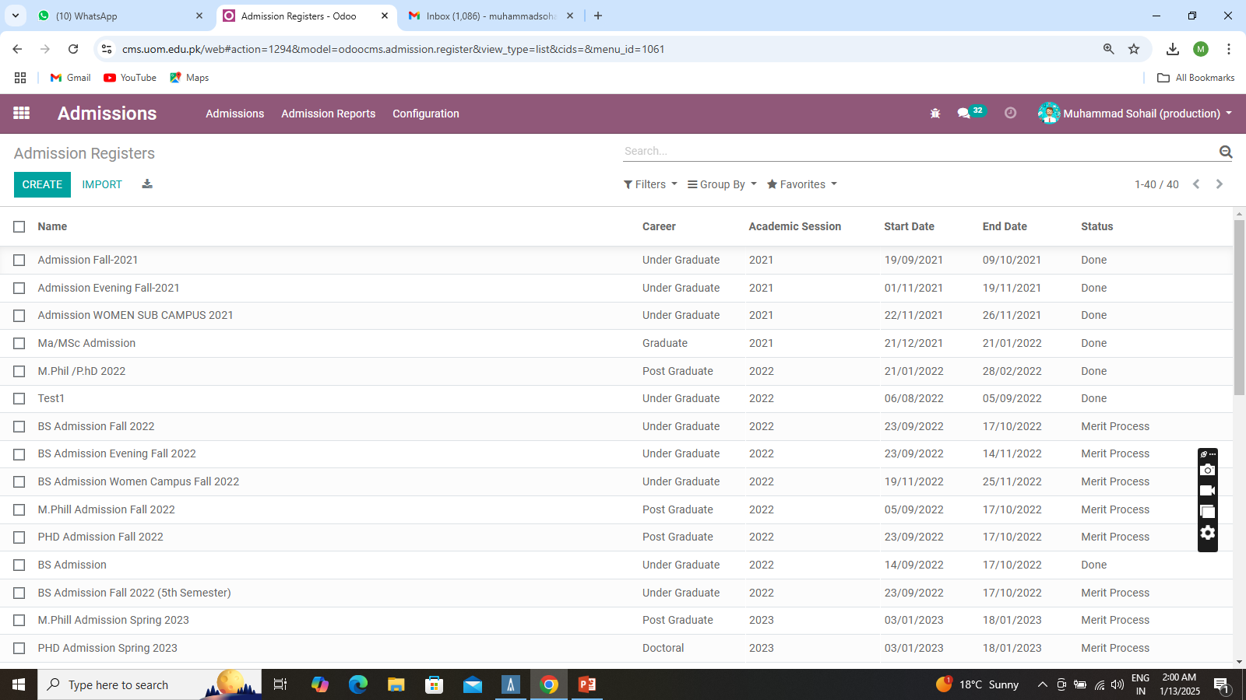
Create Admission Register
To create admission register click on ‘Admission’ menu then ‘Admission Register’ menu
Click on Create button a form will be open.

Slide 5
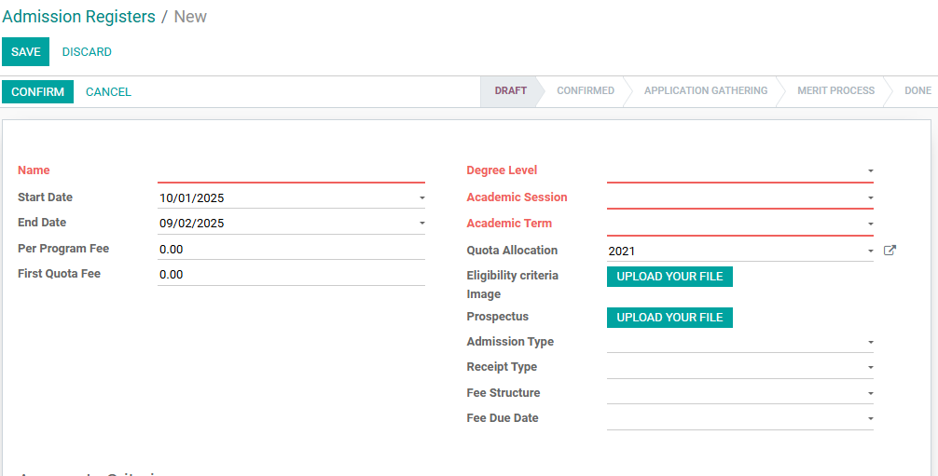
Fill in all the required information in the form

Slide 6
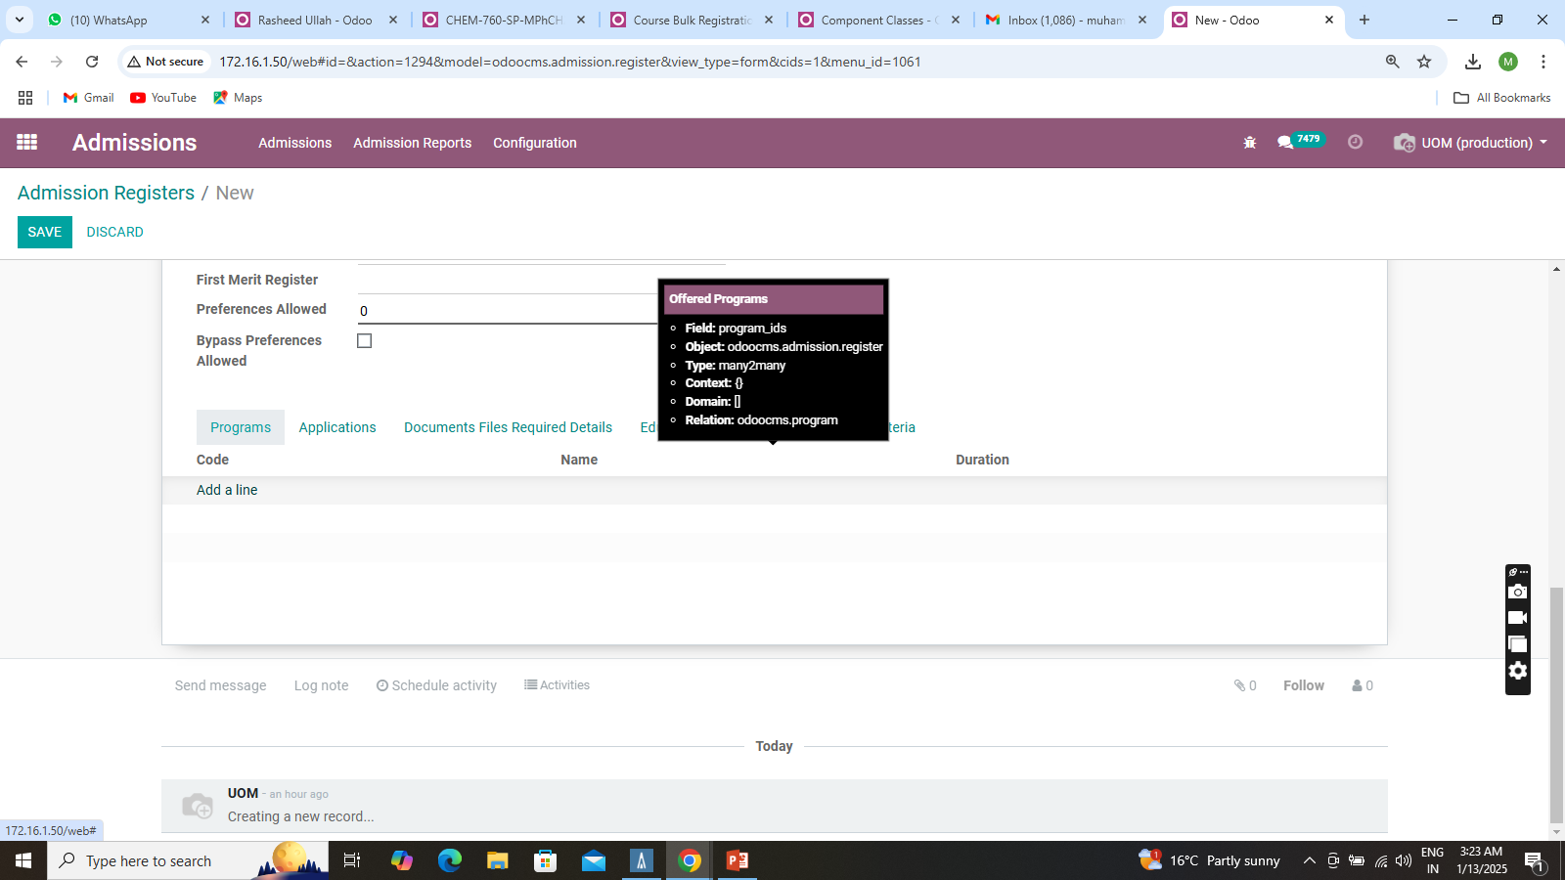
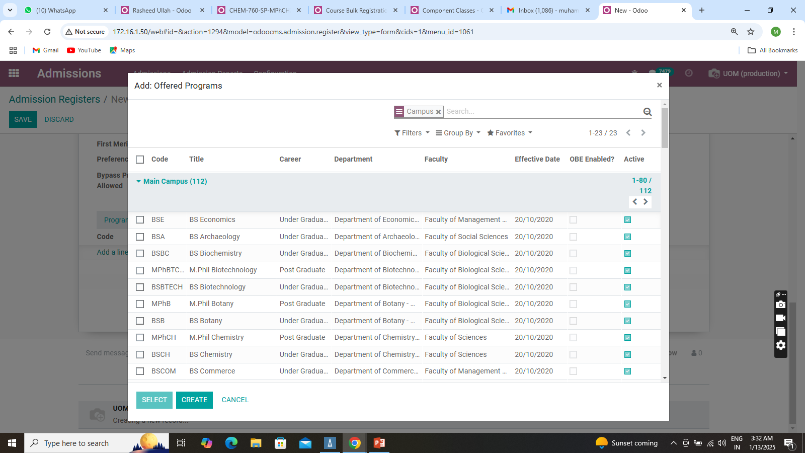
The second step is to add program into the admission register. we add those programs in which we offer admission.
ADD PROGRAMS
Go to ‘programs’ tab click on ‘add a line’ a form will open which contain all program so select group by ‘Campus’
Select program in which admission offer. will check the checkbox at near the code field, and then click on ‘SELECT’ Button.

Slide 7
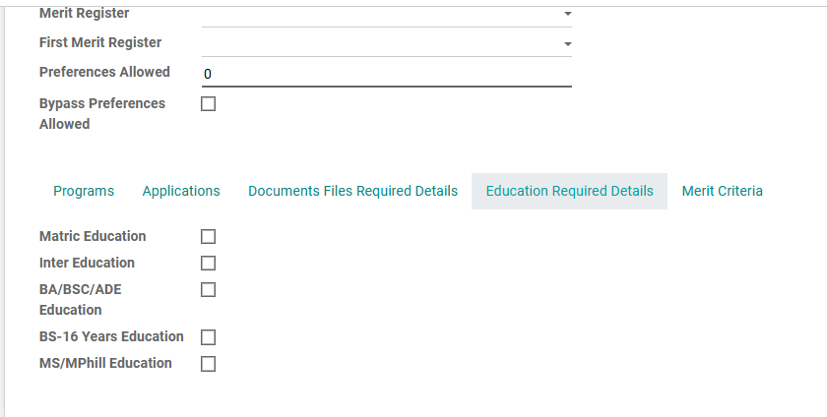
EDUCATION REQUIRED DETAILS
After selecting programs then go to ‘Education Required Details’. In this tab we tick the check box on education details required in admission from applicants.
In BS Admission Matric and Enter Details are required.
In M.Phil (Matric, inter, BS-16 Years Education) and also option for BA/BSC/ADE Education if some one have the two year degree. And so on for phd as well.
Check these option base on admission.

Slide 8
FEE SETUP
We use three fields to set up the fee for applicants:
Per Program Fee:
This is the fee charged for each program the applicant selects.
Preferences Allowed:
This is the number of programs the applicant is required to choose. For example, if you set it to 3, the applicant must select 3 programs.
Bypass Preferences Allowed:
If this option is checked, the applicant can select programs in combinations of 3, 6, or 9.

Slide 9
HOW THE ‘Bypass Preferences Allowed’ FIELD WORKS
IF "Bypass Preferences Allowed" is checked:
The applicant can select the number of programs in combination you allowed
If you set the fee to RS 2500 and allow 3 preferences,
the applicant will allow to select 3, 6, or 9 preferences. They can select more than 3. and the fee will be calculate base on that like for 3 = 2500, for 6 = 5000 for 9 = 7500. in This means the applicant doesn’t need to create a new application to choose more programs; they can select additional programs within the same application.
IF "Bypass Preferences Allowed" is NOT checked:
The applicant can only select the exact number of programs you allowed in Preferences Allowed field.
The fee is based on the number of programs allowed.
If you set the fee to 2500 and allow 3 preferences, the applicant pays 2500 for selecting 3 programs. They can’t select more than 3.

Slide 10
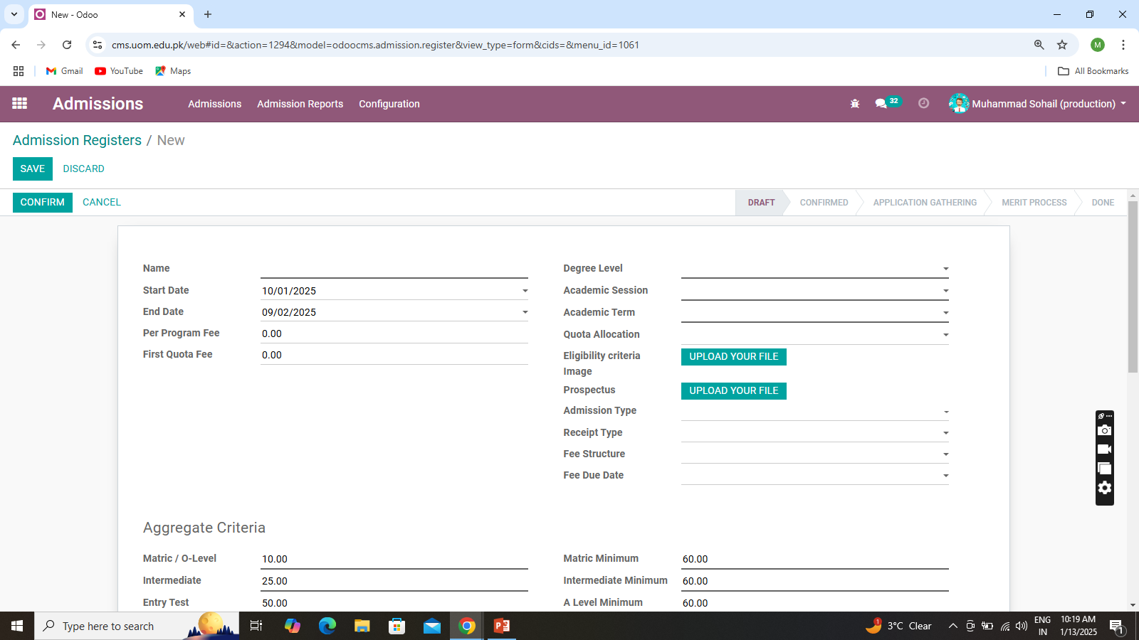
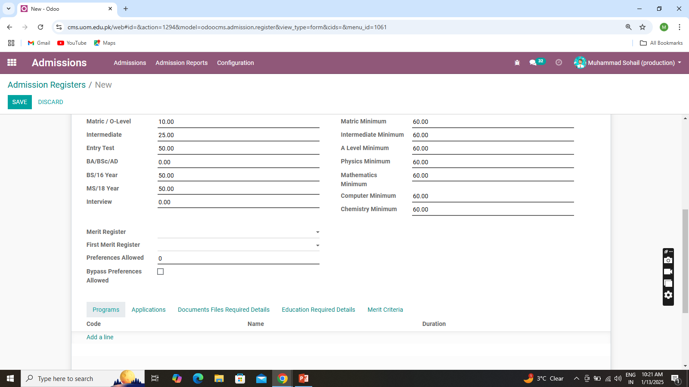
1.Per Program Fee
2.Preference Allowed
3.Bypass Preferences Allowed

Slide 11
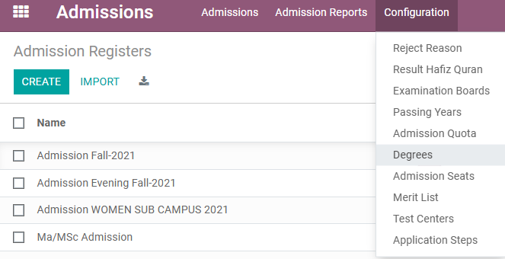
ADD DEGREES
After creation of register add program education details and fee setup next step is create degree and add link with admission register.
Here Degree mean we set the criteria on last degree. That In which program the applicant can applicable.
For BS you can create Pre-Engineering, Pre medical, ICS,FA,DAE
For M Phil you can create BS/M.SC (16 Years)
For PhD you can create MS/MPhil
To create Degree click on ‘Configuration’ Menu then click on Degrees.

Slide 12
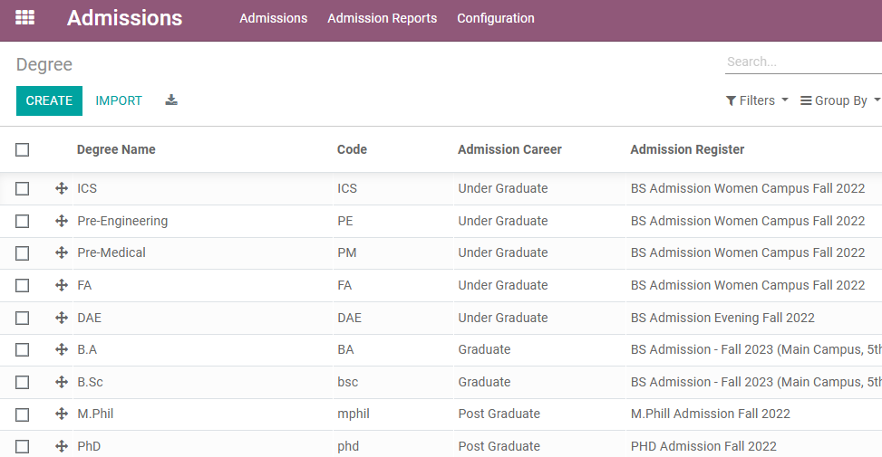
This Screen will be open click on ‘CREATE’ button.

Slide 13
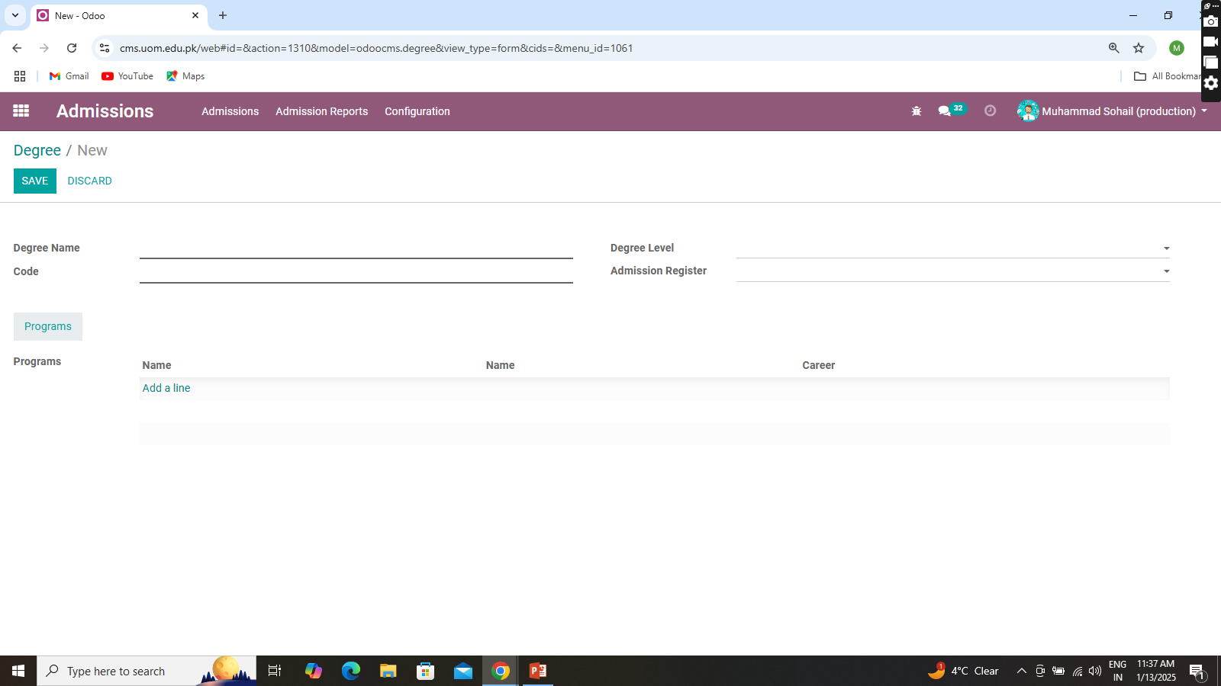
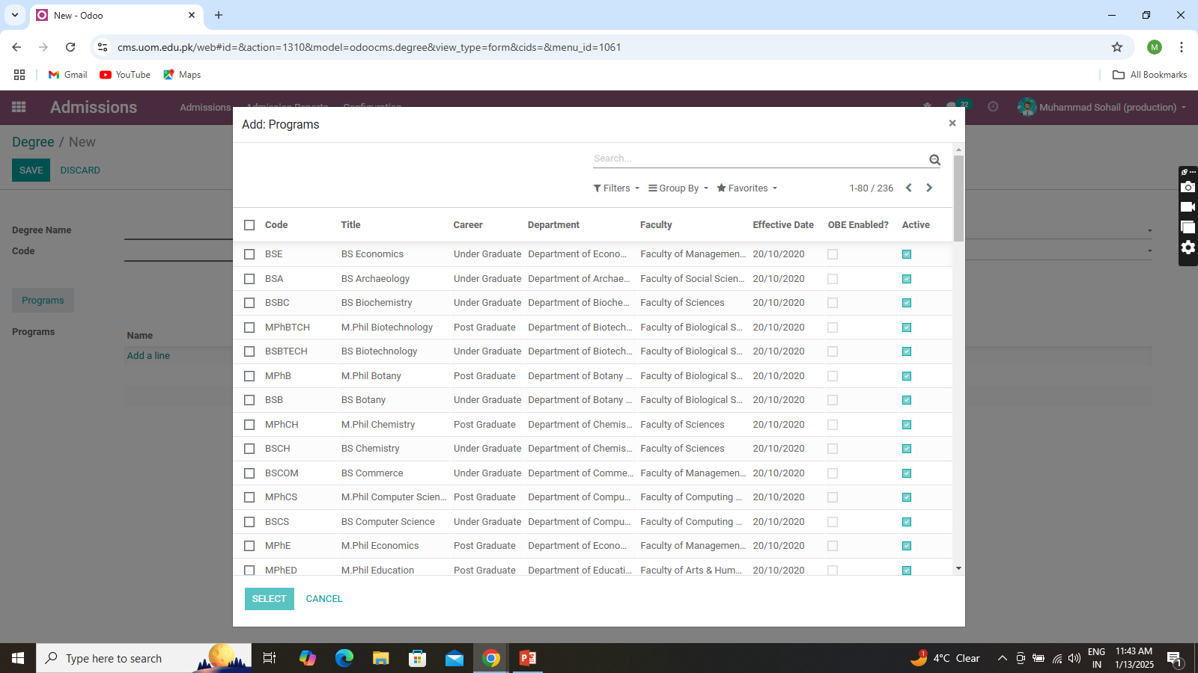
Fill this field
Here Select the Admission register you created for apply
Add program click on add line button
Select Program then click on ‘SELECT’ Button and then save.

Slide 14
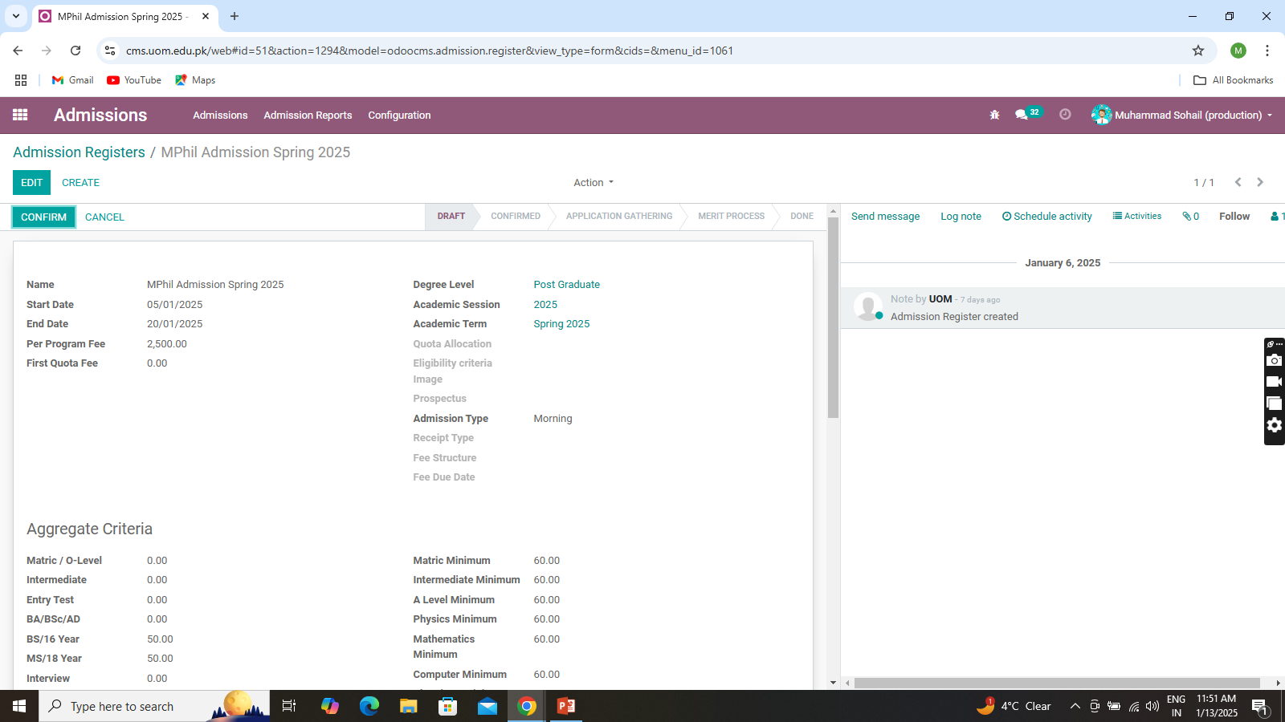
Start admission register
After do all steps we discussed above. Then start admission.
After Confirmed click on button ‘Start Application gathering. Register state set to ‘APPLICATION GATHERING’. And it will be available for apply.
Initial the register in draft state. So a button show ‘CONFIRM’ click on register move to confirmed state

Slide 15
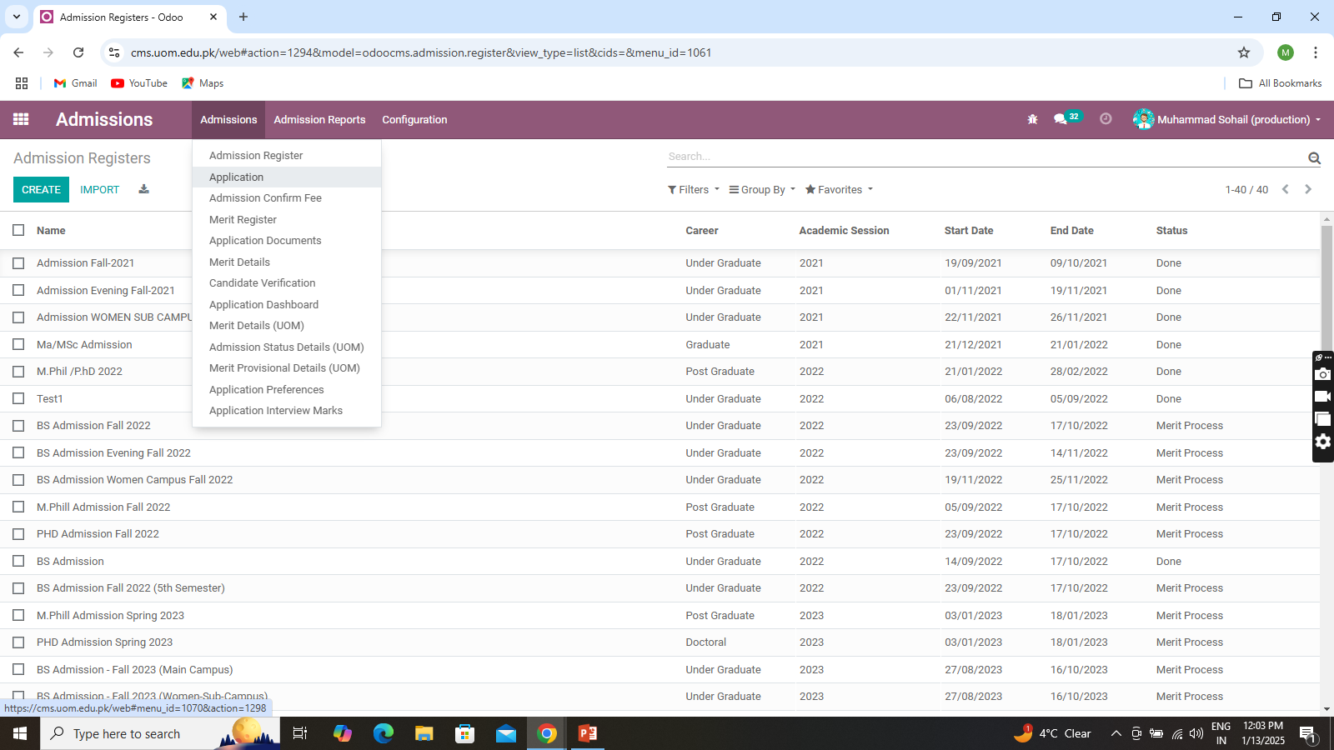
Check applications (Apply forms)
To check apply form submitted by applicant. Go to ‘Admissions’ Menu then click on Application.
Initial the register in draft state. So a button show ‘CONFIRM’ click on register move to confirmed state

Slide 16
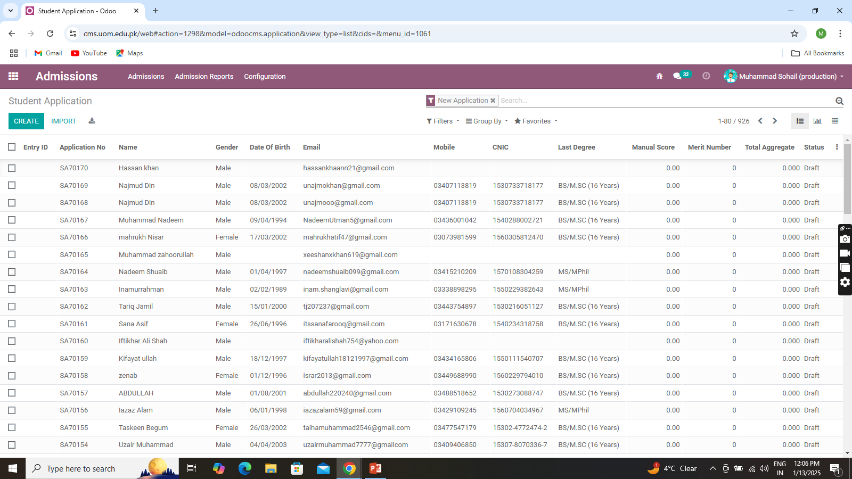
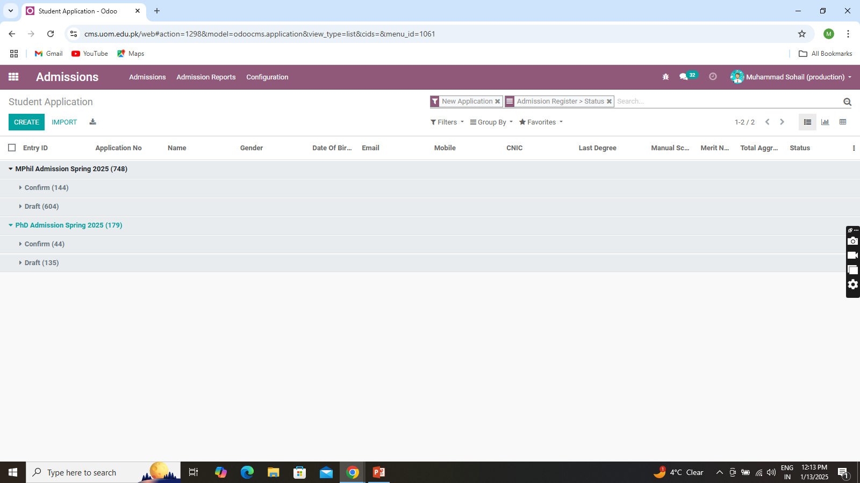
After click on application menu this screen will show. By default filter is apply ‘New Application’ which show new applications data
Initially when application is in draft state. When applicant submit it it set confirm state. After that when finance department paid the payment it move to verified state
So you can group by Admission Register then status so it will show the status of application. You can apply different filter and groups for report purpose

Slide 17
Thank you
Any Question?

